Slide 1
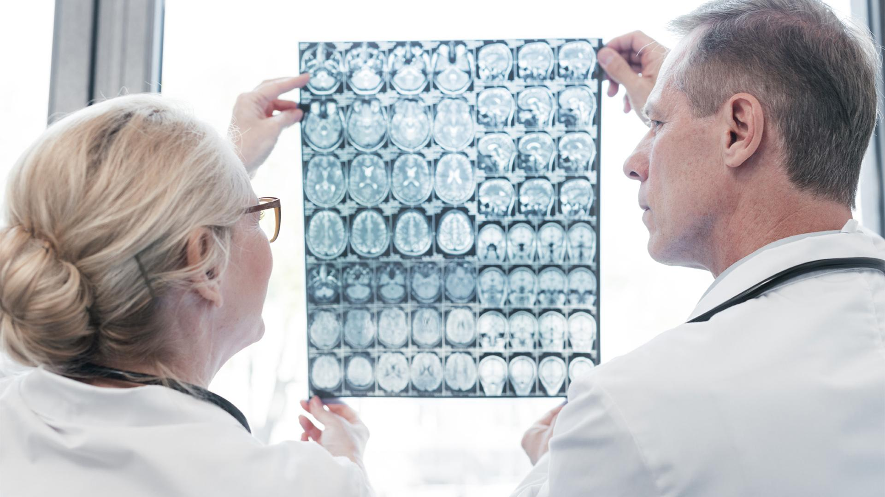

DETECTION OF BRAIN TUMOR USING MRI IMAGES
Xinyu Shi, Manish Sharma

Slide 2
TABLE OF CONTENTS
01
02
03
INTRODUCTION
OUR GOAL
METHODS
04
05
06
RESULTS
DISCUSSION
REFERENCE
Why is it important to detect the tumor in brain and why do we use MRI images
Develop an algorithm to detect the existence of tumor under a high accuracy
How do we design the algorithm
Our accuracy and validation
What is the limitation and possible improvements
Cited paper and literature

Slide 3

01
INTRODUCTION

Slide 4
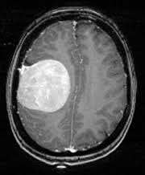
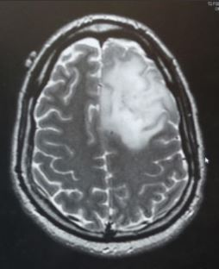
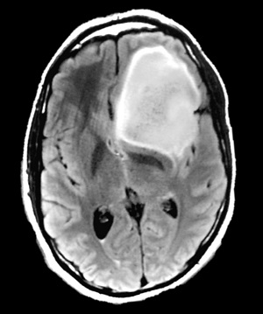
BACKGROUND
A brain tumor is an abnormal mass of tissue in which cells grow and multiply uncontrollably. When tumors grow, they can cause the pressure inside your skull to increase. This can cause brain damage, and it can be life-threatening. According to the GLOBOCAN 2020 survey conducted by the International Agency for Research on Cancer (IARC), there will be 3,08,102 people diagnosed with brain tumours around the world, with more than 2,50,000 deaths.
Notes:
A brain tumor is an abnormal mass of tissue in which cells grow and multiply uncontrollably,
seemingly unchecked by the mechanisms that control normal cells. When tumors grow, they
can cause the pressure inside your skull to increase. This can cause brain damage, and it can be
life-threatening. According to the GLOBOCON 2020 survey conducted by the International Agency for Research on Cancer (IARC), there will be 3,08,102 people diagnosed with brain tumours around the world, with more than 2,50,000 deaths. There have been 8,37,152 cases of brain tumours in the last 5 years.Brain tumours can be treated with surgery, radiation therapy, chemotherapy, and targeted therapy. However, early and accurate tumour diagnosis is critical in order to save death and improve the chances of a successful recovery.
When it comes to spotting a tumour, doctors can use an X-ray, CT scan, or MRI. However, MRI is usually more informative since it provides more exact information about the tumour’s nature, location, and size. MRI distinguishes soft tissue better than CT It can distinguish fat, water, muscle, and other soft tissue better than CT scans. When compared to other methods, it frequently gives accurate representations of body locations. MRIs are sufficient when all other tests fail to offer sufficient detail. The properties of magnetism and radio waves are combined in an MRI scan to produce accurate images.

Slide 5
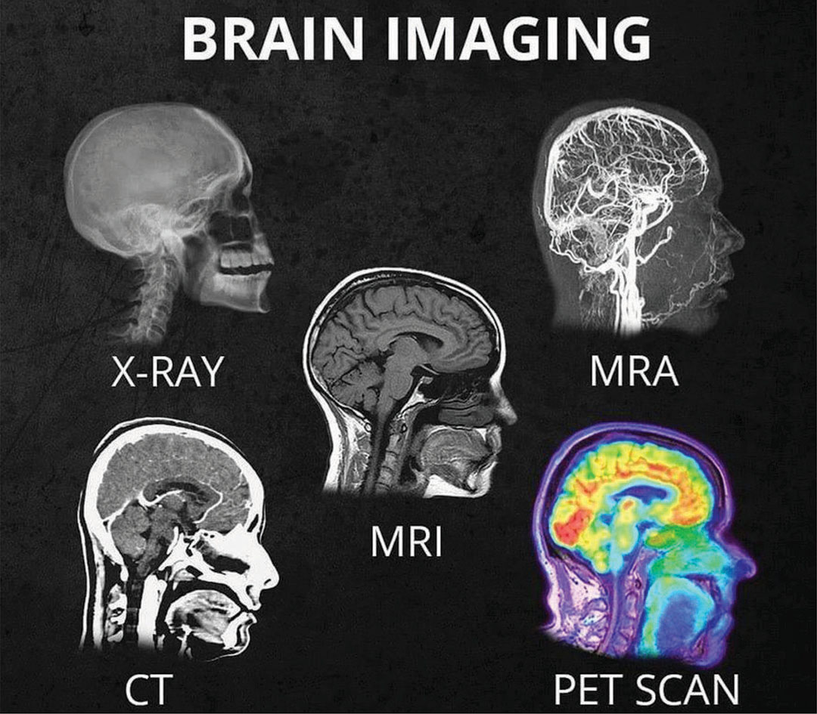
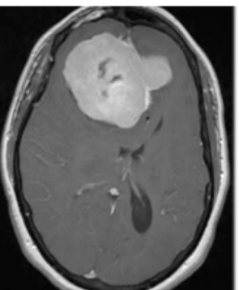
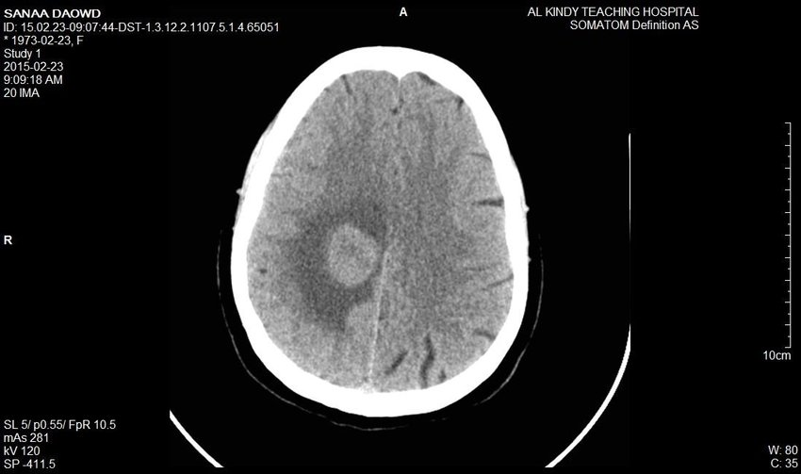
SIGNIFICANCE OF BRAIN TUMOR DETECTION AND WHY MRI
Can be treated with surgery, radiation therapy, chemotherapy, and targeted therapy
However, early and accurate tumour diagnosis is critical in order to save death and improve the chances of a successful recovery
Common medical imaging technique: X-ray, CT scan, or MRI
MRI is more informative and it provides more exact information about tumor
MRI distinguishes soft tissue better than CT, it can distinguish fat, water, muscle…
Accurate representations of body locations
X-ray
CT scan
MRI

Slide 6
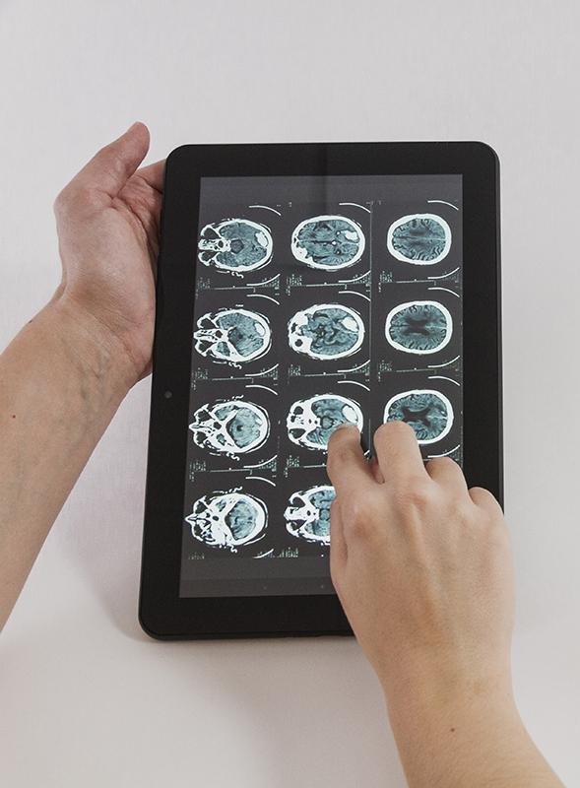
02
OUR GOAL

Slide 7
UNMET NEED
Current limitations of MRI imaging
Dangerous for pacemaker and metal implant users since it employs magnetic radiation
Substantial yet time-consuming manual process performed by medical experts of tumours segmentation
The accuracy depends on the expert’s experience
How do we tackle the problems?
Once we have a scanned image of the brain, it is critical to accurately detect tumour
Have an algorithm that can automatically detect and segment brain tumors from an MRI
Notes:
However, because MRI employs magnetic radiation, it is dangerous for pacemaker and metal implant users. Once we have a scanned image of the brain, it is critical to accurately detect tumours, their size, and their location. All of this awareness is necessary for the neurosurgeon to finalise his or her diagnosis. A substantial yet time-consuming manual process performed by medical experts is tumours segmentation from magnetic resonance imaging (MRI) data. It is possible to manually segment or isolate brain tumours from an MRI. But it is complicated and time consuming. Although, the accuracy depends on the expert's experience. The overall MRI brain tumour detection method can be categorised into four different categories: pre-processing, segmentation, morphological process, and extraction of features.

Slide 8
03
METHODS

Slide 9
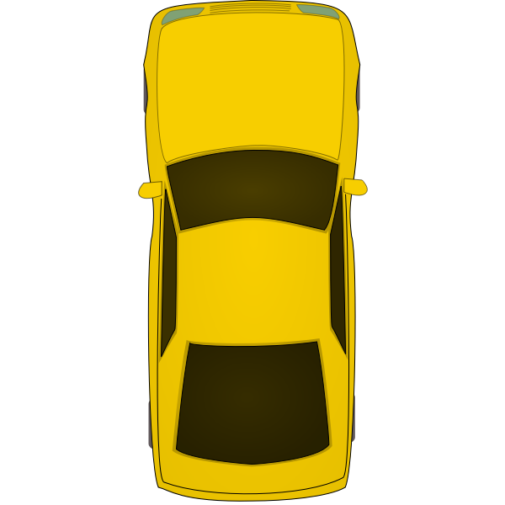
ROADMAP
MRI images
01
Grayscale Conversion
High pass filter
02
Median filter
03
Thresholding segmentation
04
Tumor extraction
05
Morphological operation
06
Detection result
Notes:
We tested our algorithm using data from "Kaggle." Here is the route for our journey as a whole:

Slide 10
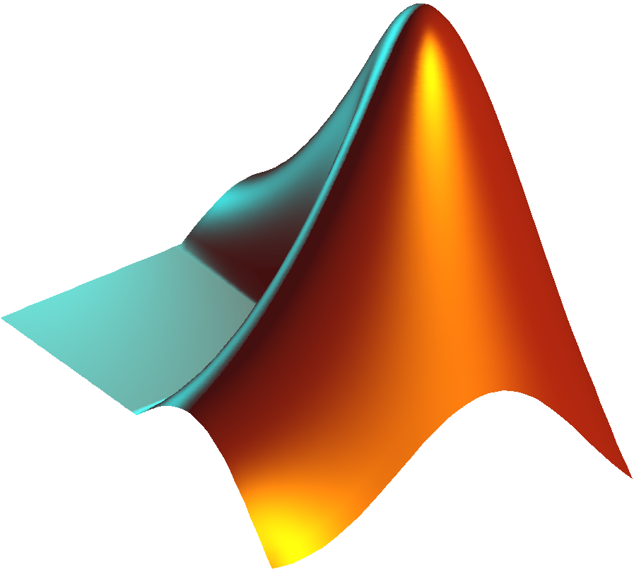
PROBLEMS
Filters
Threshold Segmentation
Tumor Extraction
We first transformed the grayscale image to FFT
Then we used two filters:
High pass filter
Median filter
Converted to binary and then threshold at 100 and to get more specific details thresholding at 150
The skull around the tumor is then removed as we filter it out
Notes:
Trail , possible algorithm

Slide 11
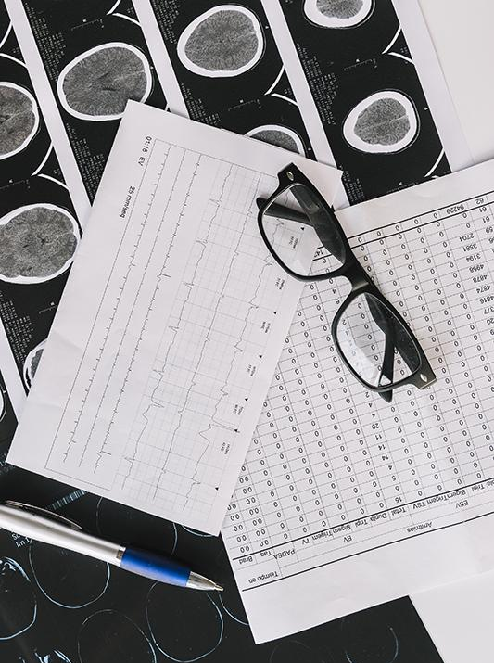
04
RESULTS

Slide 12
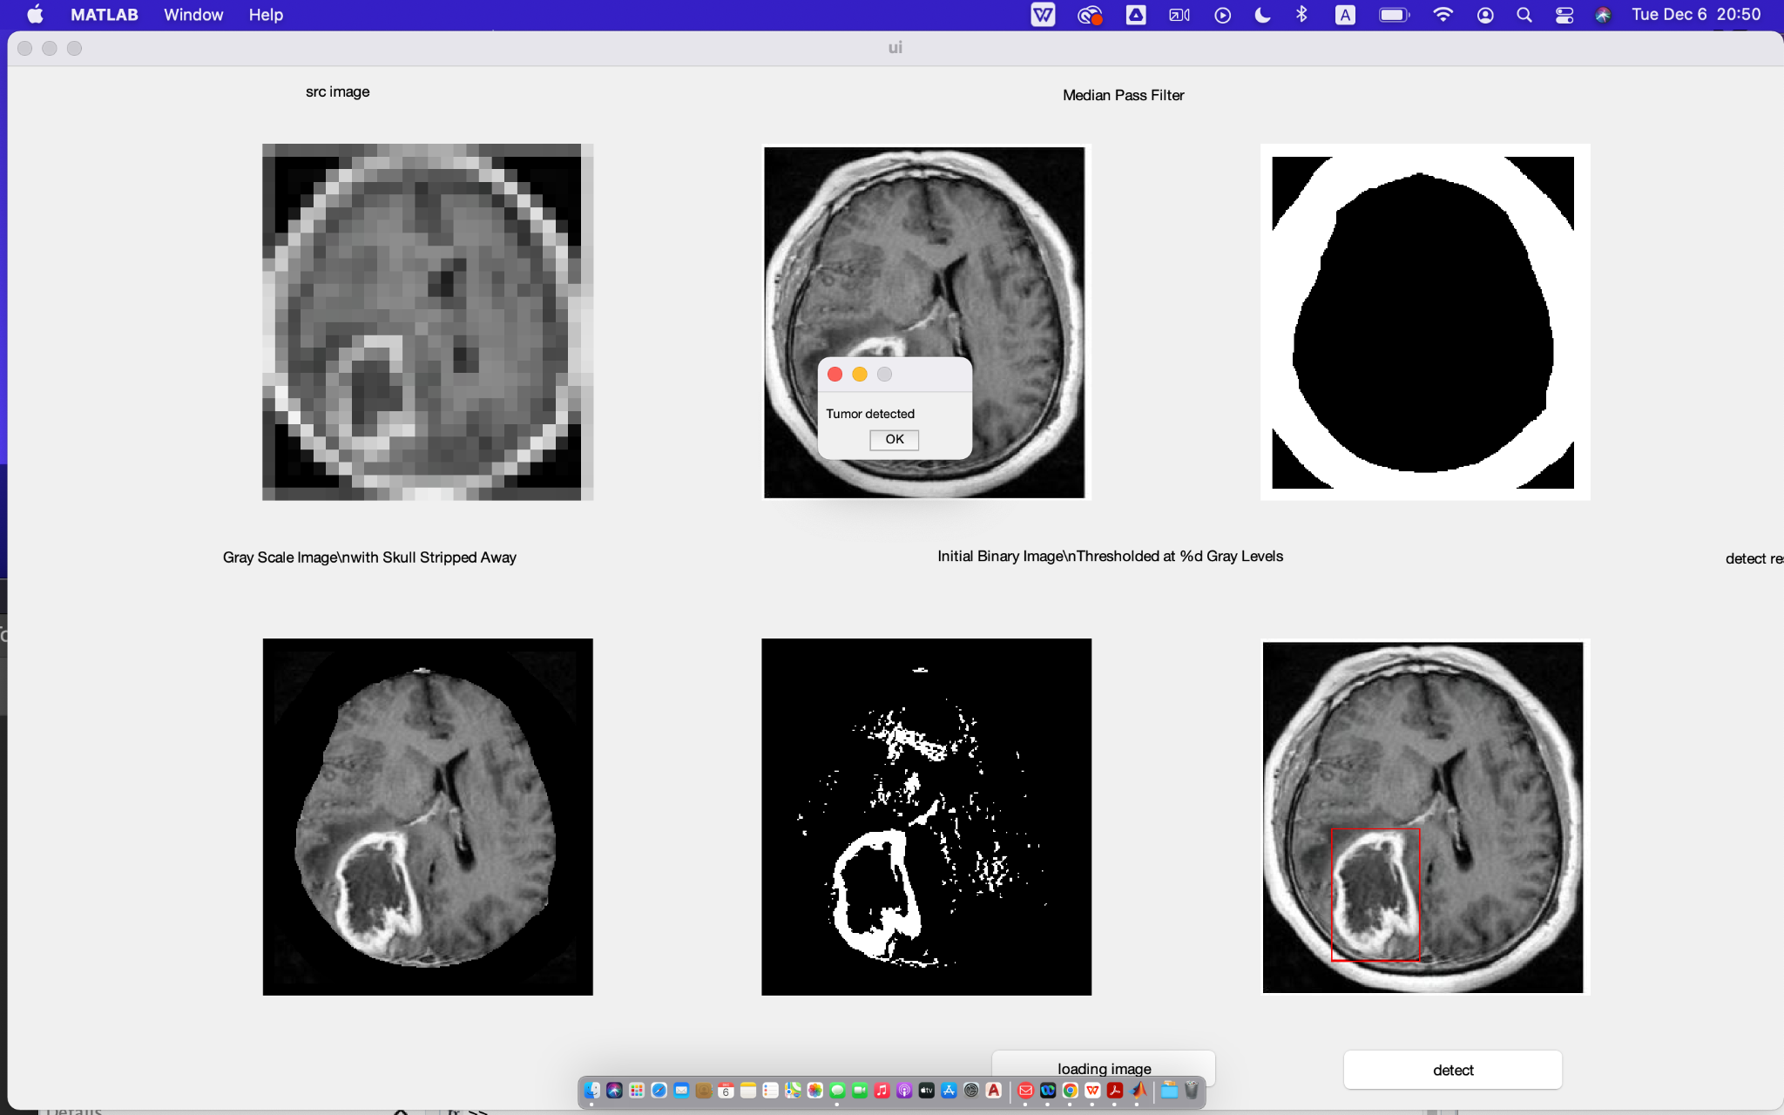
VALIDATIONS
Focus on applying image processing to extract the tumor from MRI brain images
The necessity of preprocessing techniques: segmentation, morphological operations and subtraction
Provides precise shape of the tumor and enables identification of brain tumors in MRI scans
Notes:
A brain tumor is an abnormal mass of tissue in which cells grow and multiply uncontrollably,
seemingly unchecked by the mechanisms that control normal cells. When tumors grow, they
can cause the pressure inside your skull to increase. This can cause brain damage, and it can be
life-threatening. According to the GLOBOCON 2020 survey conducted by the International Agency for Research on Cancer (IARC), there will be 3,08,102 people diagnosed with brain tumours around the world, with more than 2,50,000 deaths. There have been 8,37,152 cases of brain tumours in the last 5 years.Brain tumours can be treated with surgery, radiation therapy, chemotherapy, and targeted therapy. However, early and accurate tumour diagnosis is critical in order to save death and improve the chances of a successful recovery.
When it comes to spotting a tumour, doctors can use an X-ray, CT scan, or MRI. However, MRI is usually more informative since it provides more exact information about the tumour’s nature, location, and size. MRI distinguishes soft tissue better than CT It can distinguish fat, water, muscle, and other soft tissue better than CT scans. When compared to other methods, it frequently gives accurate representations of body locations. MRIs are sufficient when all other tests fail to offer sufficient detail. The properties of magnetism and radio waves are combined in an MRI scan to produce accurate images.
We focused on applying image processing to extract the tumor from MRI brain images. Since the position of a brain tumor cannot be precisely determined by an MRI scan, preprocessing techniques including segmentation, morphological operations, and subtraction are employed to determine the tumor's precise location. This provides the precise shape of the tumor in that MRI image, enabling the identification of brain tumors in MRI scans.

Slide 13
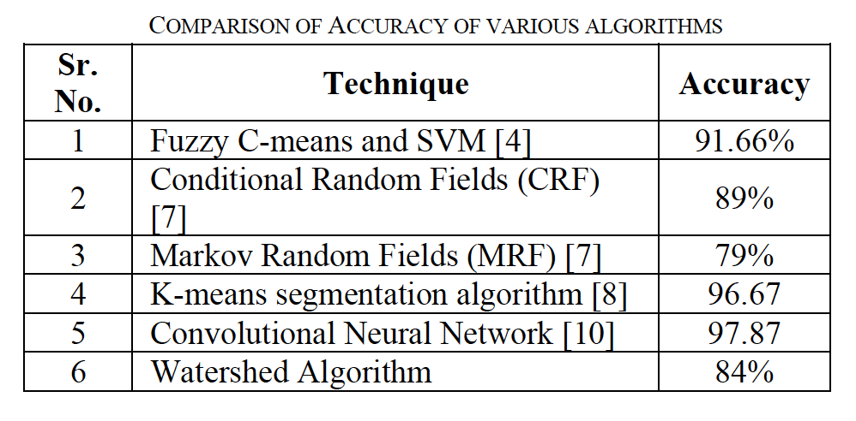
Gold standard
Our algorithm accuracy: 60%
Sample size: 10
Notes:
Don’t talk about no tumor, if she asked, say we tried it using GUI, have no experience of that before, so still working on it.

Slide 14
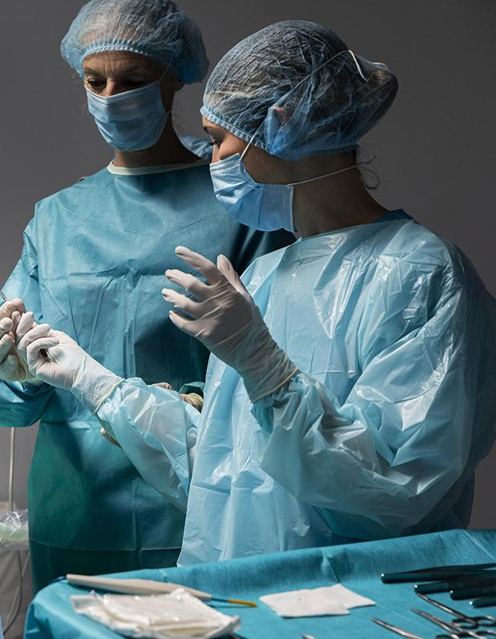
05
DISCUSSION AND CONCLUSION

Slide 15
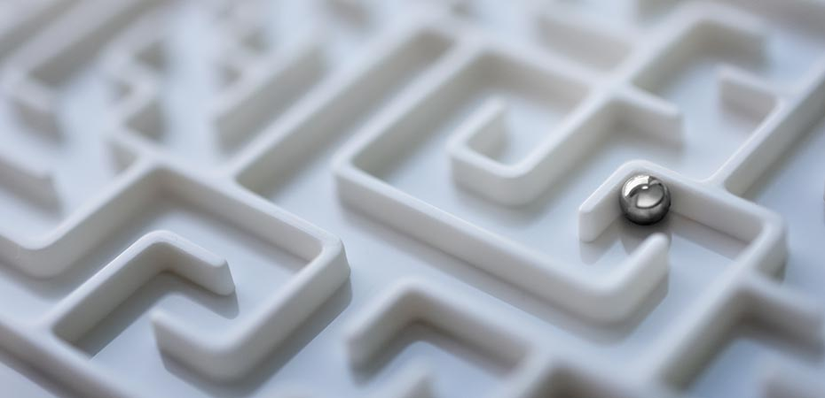
Limitations
We used the "Kaggle" MRI brain Tumor dataset, which offers very high-quality pictures.
Our system worked with the majority of the photos in the dataset to separate the tumor from the brain for much better viewing.
If we use photographs from a random dataset, our outcomes will vary.
The algorithm cannot determine whether the problem is a tumor, an injury, a blood clot, or something else.
Notes:
Limitations (what kind of input data are required for you algorithm; what kind of data will not be possible to handle; what kind of preprocessing is needed, if any?)
Detect something that is not a tumor
Blood clogging
Image quality
Dataset random

Slide 16
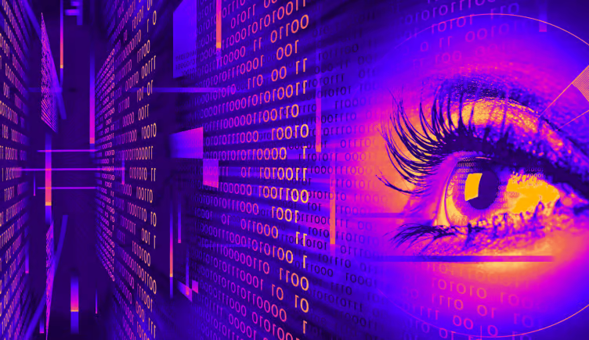
Improvement
Matlab's Image processing package can be supplemented with a graphical user interface to achieve amazing results.
We can utilize the machine learning toolbox in Matlab to design a much better model and train it, allowing us to use a random dataset and get highly accurate results.
Computer vision, in conjunction with deep learning, can be used to separate tumors from MRI images.
Notes:
GUI
Computer vision
Machine learning

Slide 17
REFERENCE
World Health Organization, International Agency for Research onCancer (IARC), The Global Cancer Observatory, GLOBOCAN2020: New Global Cancer Data estimated cancer incidence,Accessed on May 2021, Available on: https://gco.iarc.fr/today/data/factsheets/populations/900-world-fact-sheets.pdf
Ugale, V. D., Pawar, S. S., & Pawar, S. (2022, April). Brain Tumour Detection using Image Processing. In 2022 IEEE 11th International Conference on Communication Systems and Network Technologies (CSNT) (pp. 667-672). IEEE.
Patil, R. C., & Bhalchandra, A. S. (2012). Brain tumour extraction from MRI images using MATLAB. International Journal of Electronics, Communication and Soft Computing Science & Engineering (IJECSCSE), 2(1), 1.

Slide 18

THANKS!
DO YOU HAVE ANY QUESTIONS?

